Slide 1

Competitive Analysis

Slide 2
Introduction
Founded: 2018
Headquarters: San Francisco United States.
Company size: 201-500.
Industries: Human Resources, Mobile Apps, Recruiting.
Recruiters: Lenskart, Byju’s, Ajio.com, square yards, Flipkart, etc.
Hirect is a chat-based mobile-first direct hiring platform designed specifically for high-growth start-ups and SMEs. It connects start-up job aspirants with start-up leaders without any middleman and vice versa.
Hirect offers direct chat and video call features which have enabled over 3M job seekers to connect directly with over 190K recruiters on their platform.

Slide 3




01
02
03
04
Product analysis
Business model
Unique Selling proposition
Marketing Model

Slide 4
05
06
07
08
Social Media and digital Marketing
Growth Tactics
SWOT Analysis
Review Tracker

Slide 5
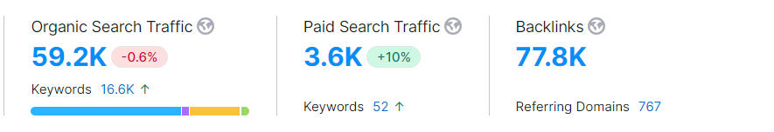
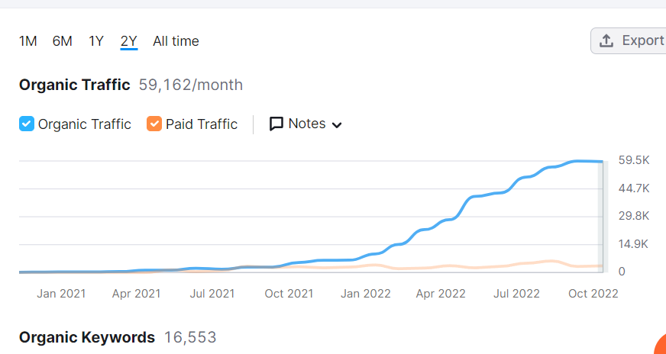
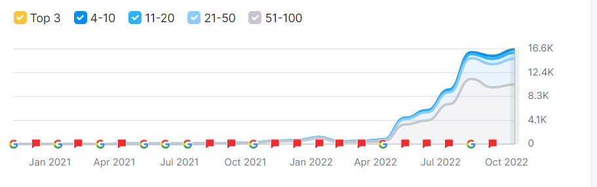
Product Analysis
Hirect uses its own Websites and mobile applications to help recruiters and job seekers to connect with each other.
As they run on Freemium model recruitment so that they can access unlimited features.
According to Semrush, their monthly Organic Search is 59.2K and their paid search is 3.6k.
Organic Keyword appearance is 16,553K.

Slide 6
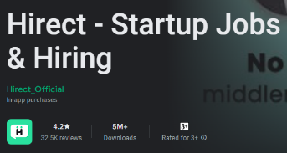
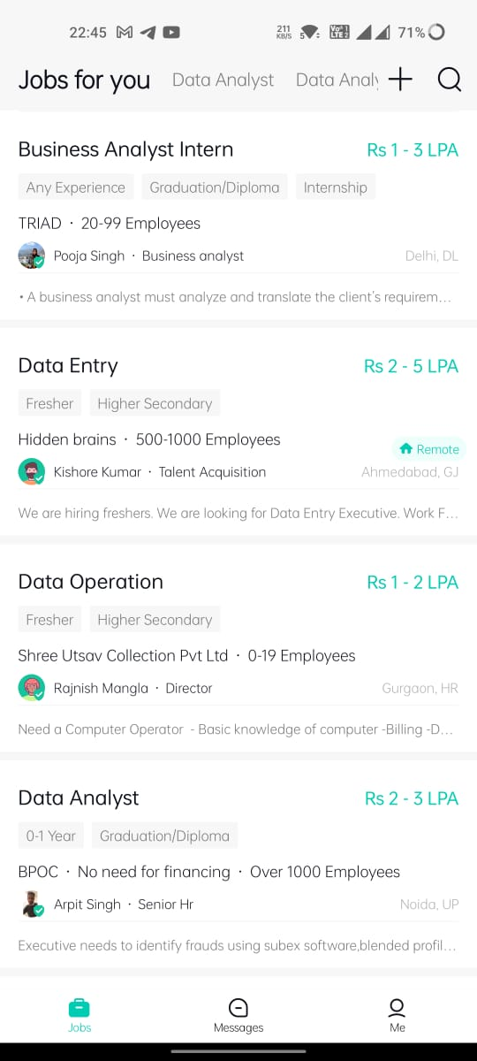
Product Analysis
Hirect uses applications for phones.
According to the play store, they have a user
Rating of 4.2stars and 32.5k reviews.
5M+ application download.
They have a very easy-to-understand UI for their application.

Slide 7
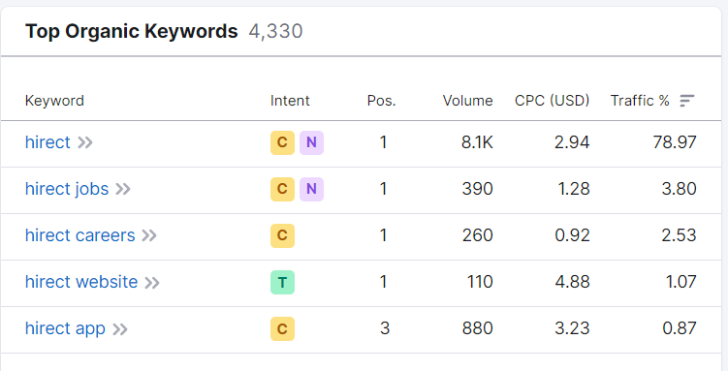
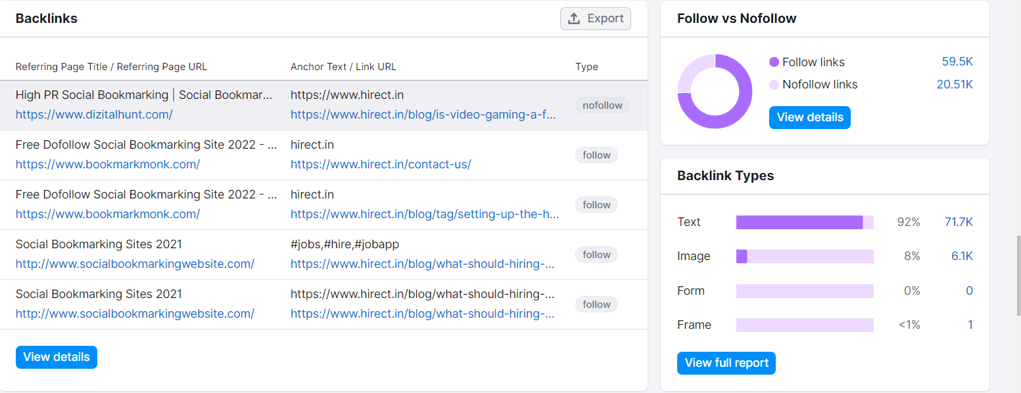
Product Analysis
The most common keywords used for organic search are hirect, hirect jobs, etc.
There are 77K+ traffic due to back links.
As there are 59.5K visitors using the follow link.
92% have use the Text as the Back Link Type.

Slide 8
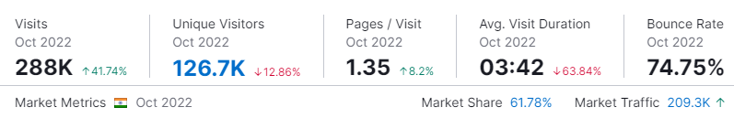
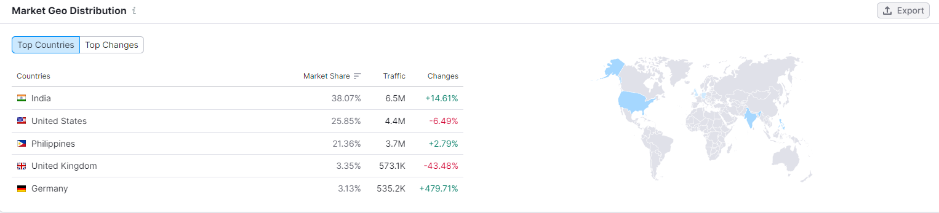
Product Analysis
There are 126.7K Unique Visitors on the Hirect Website.
Hirect Market share is 61.78% where most of the share is from India a total of 38.07%.
6.5M+ of traffic is also from India.

Slide 9
Business Model Canvas
Key Partners Tiger Global Management and DST Global are the firms that fund companies Hirect. They help Hirect through different funding rounds as currently, Hirect is in a Series A funding round, and the lead investor is Tiger Global Management | Key Activities Human resources Mobile apps Enables recruiters and job seekers to connect directly – no emails and no waiting. | Value Propositions Providing our job seekers with not only big MNCs but also a good amount of start-ups. Verified Startup Companies. A good amount of information about the jobs in a small mobile app section. For the Recruiter’s value for Value for money subscription. |  | Customer Relationships Hirect Provides 3.8M+ job seekers to target a good amount of start-up companies for a job with accessing all the features at no cost. Low-cost subscription for there 190k+ verified Recrutiers. | Customer Segments Hirect provides these services to a group of people from ages 18 to 40. Their Applications are installed by 5M+ users. They have 288k visitors and 126.7k Unique Visitors per month on their websites. Average Visit Duration is 3:42min.
 | Key Resources Mobile chat-based hiring app for startups. Freemium model for recruiters. Data Privacy |  |  | Channels Hirect as provided Website and Mobile Application for both Android and IOS. Both their products as easy to understand and have good interactive interfaces.
Cost Structure Fixed Costs (salaries, rents, utilities) Hirect is actively using 43 technologies for its website. These include Viewport Meta, IPhone / Mobile Compatible, and SSL by Default. |  |  | Revenue Streams Hirect earns through the subscription plans where they have the Freemium plan 5 chats per day and then they have the paid plans such as Basic, Standard, and Premium. Basic costs are Rs1399 per month and Rs3.10 per chat and the chat offered per day is 15. Standard costs are Rs2199 per month and Rs2.44 per chat and the chat offered per day is 30. Basic costs are Rs4499 per month and Rs1.50 per chat and the chat offered per day is 100.
D

Slide 10

Unique selling proposition
Direct Chat Feature.
Hirect runs on a Freemium So that they can use all its features without limitations
Winning Zone
Who Cares
They want free to chat and good interaction.
Hirect Competitors
They offer a premium plan for recruitment.
Losing Zone

Slide 11
Marketing Model
S
Segmentation
T
Targeting
P
Positioning
Hirect targets Job seekers who are searching for jobs and a group of people aged 18 – 40.
Hirect distinct users into two segments Job Seekers and Recruiters.
The most attractive segments to focus on would be Job Seekers

Slide 12


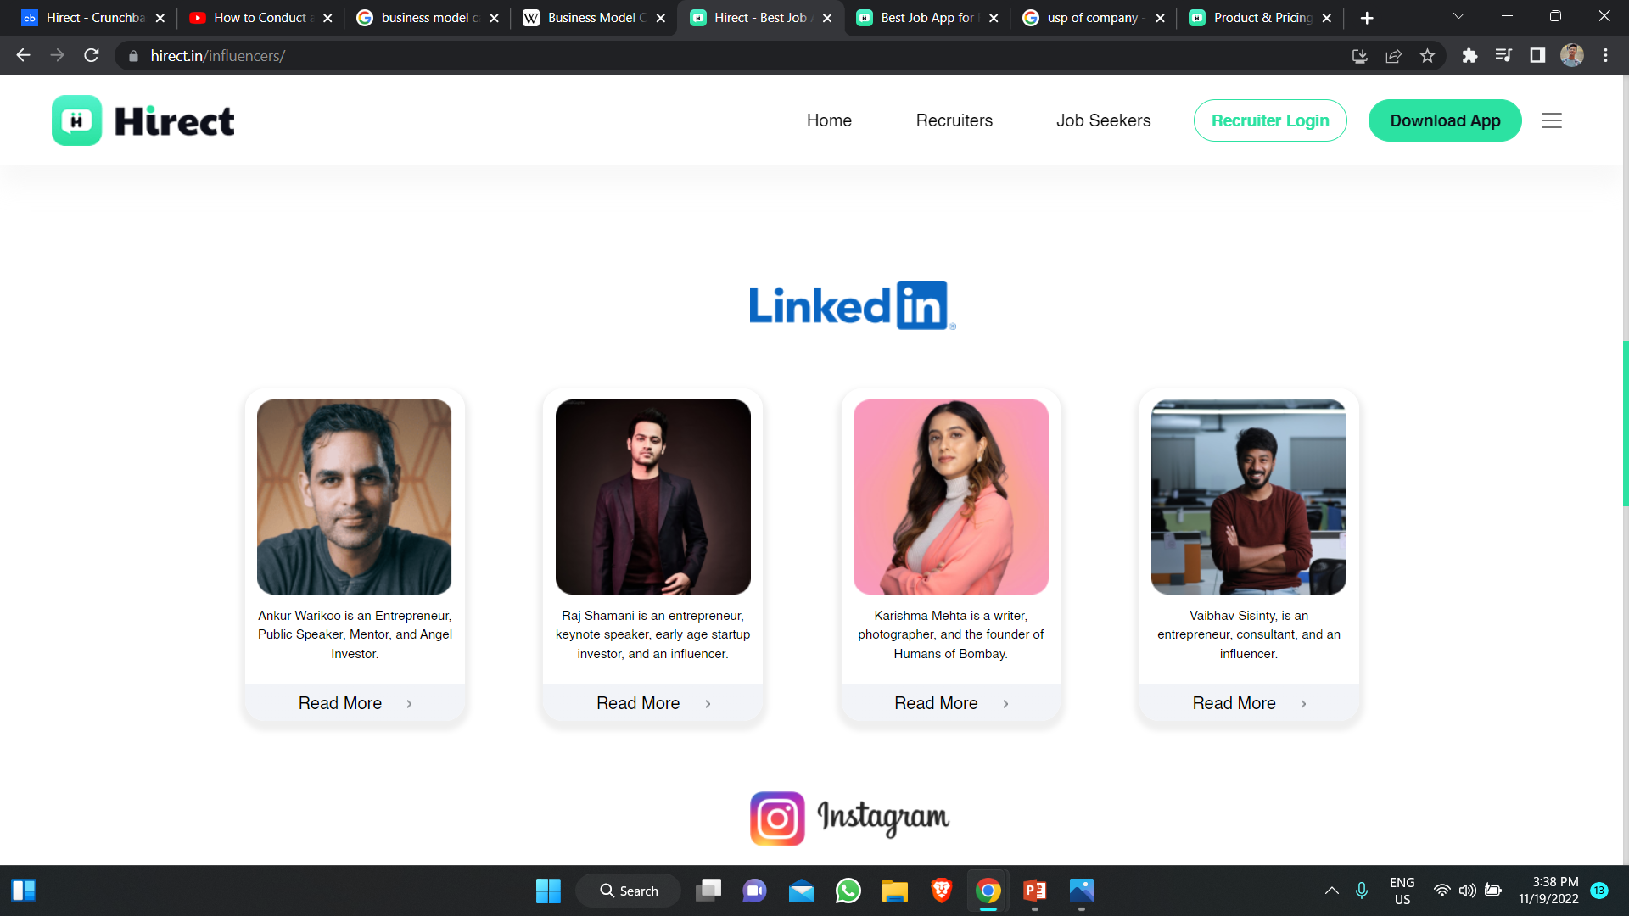
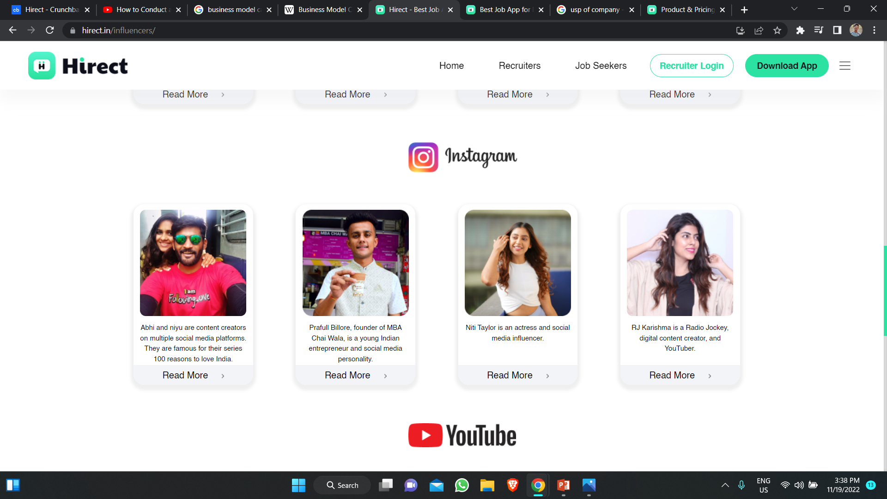

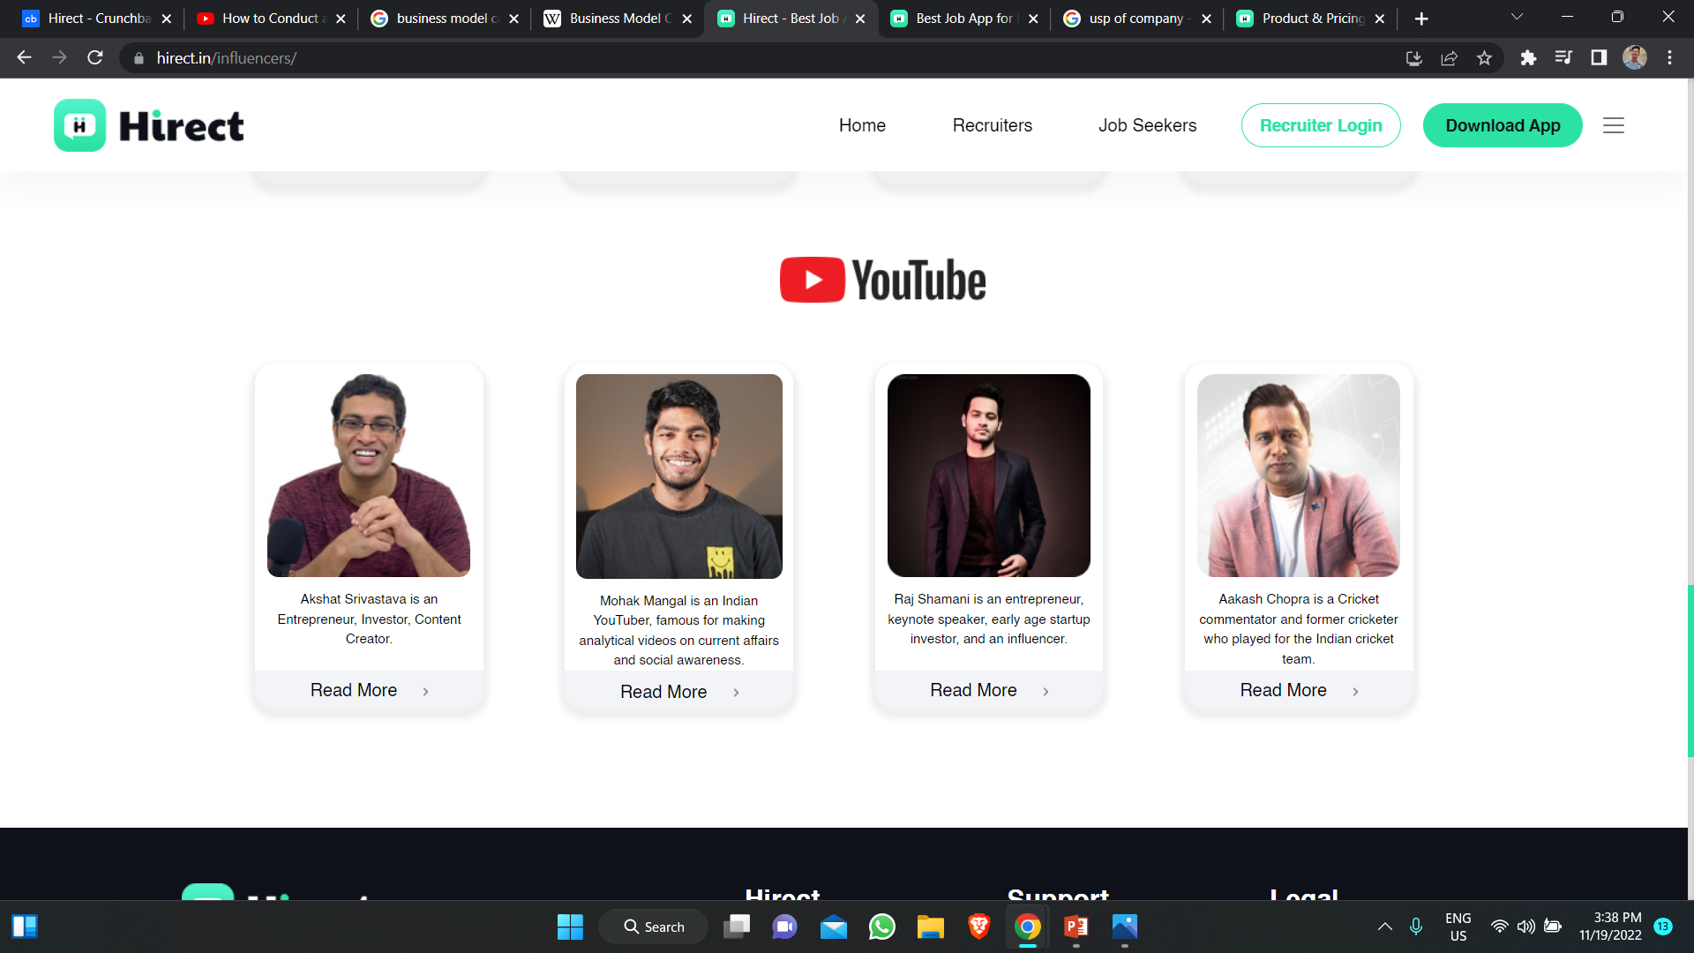
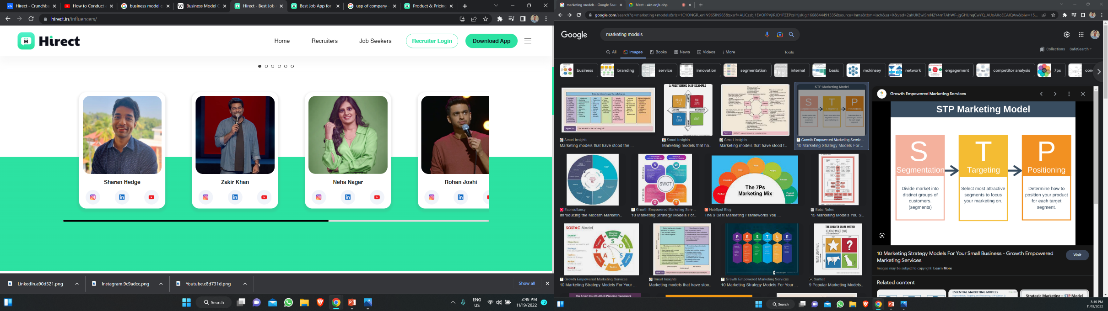
Digital Media Marketing

Slide 13
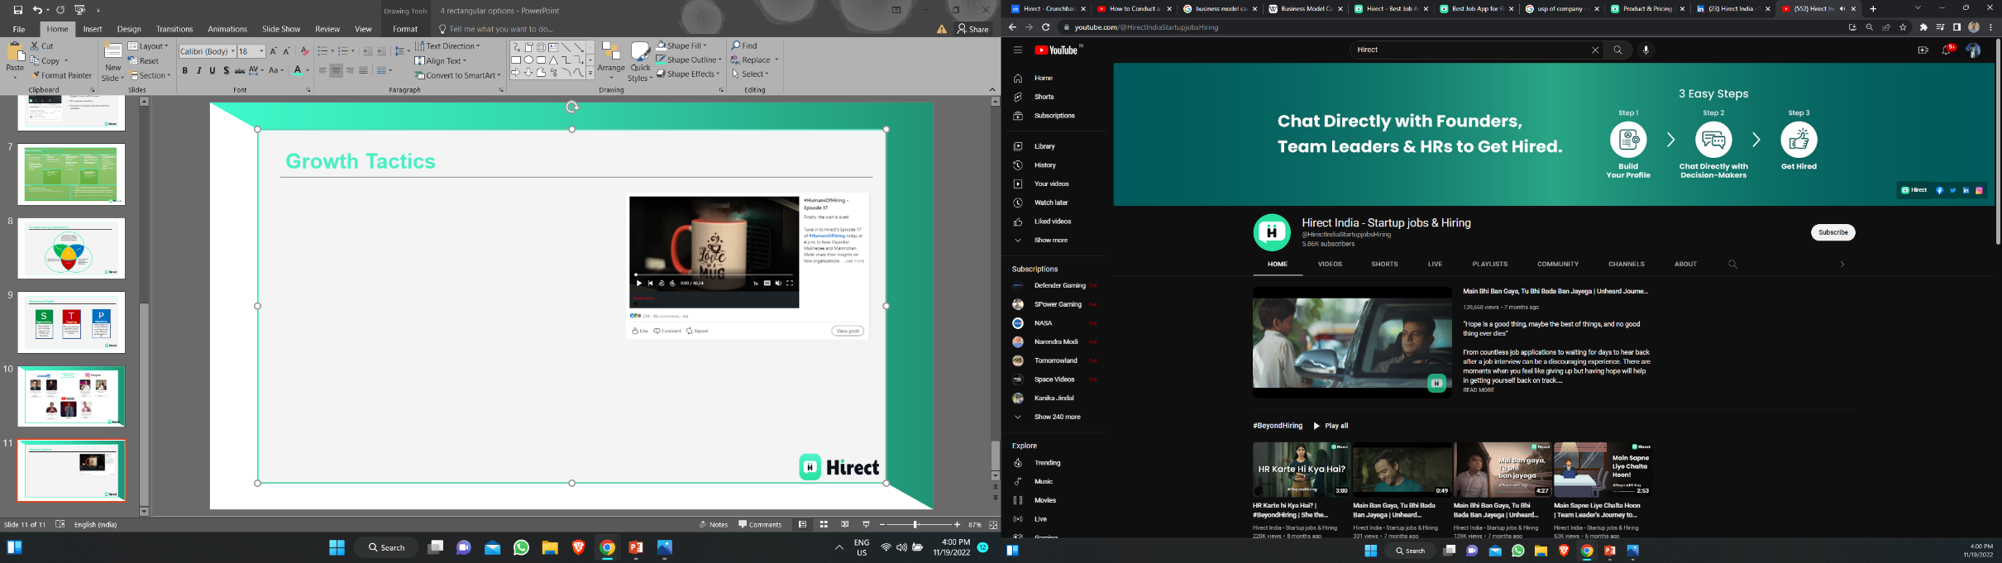
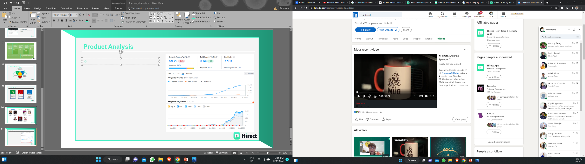
Growth Tactics
Hirect for Growth they try to promote itself on most platforms such as Linkedin, Instagram, and Youtube.
They Conduct different types of event such as #Beyond JD, #ItDoesNotMatter, #HumanOfHiring, and #ThroughFounderLens.
They are active on all the social media handles.
For Promotion of Hirect they have approached some big Youtubers and Influencers such as Gaurav Taneja, Ranveer Allhabadia, Zakir Khan.

Slide 14
SWOT Analysis
S
Direct Contact with the recruiters.
No need for external reference.
Freemium model for recruiters.
Easy and understandable UI
Instant Application.
W
Delayed reply from a recruiter.
IOS App maintains.
Fraud Calls and jobs.
O
Application Tracking System.
Learning coursework and assessment.
Creating a Chat-bot and improving UI to attract users.
T
There are many competitors out in the market who are already in this domain such as LinkedIn, Nakuri, Internshala, Angel List.

Slide 15

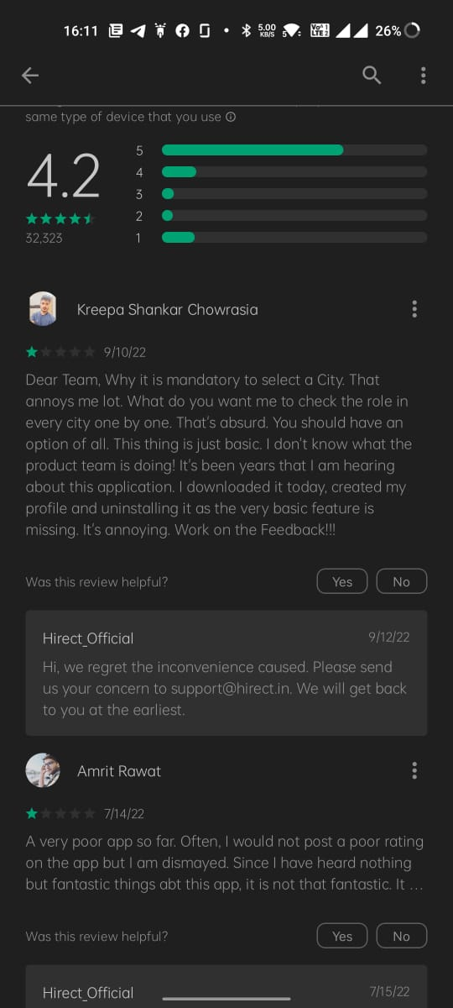
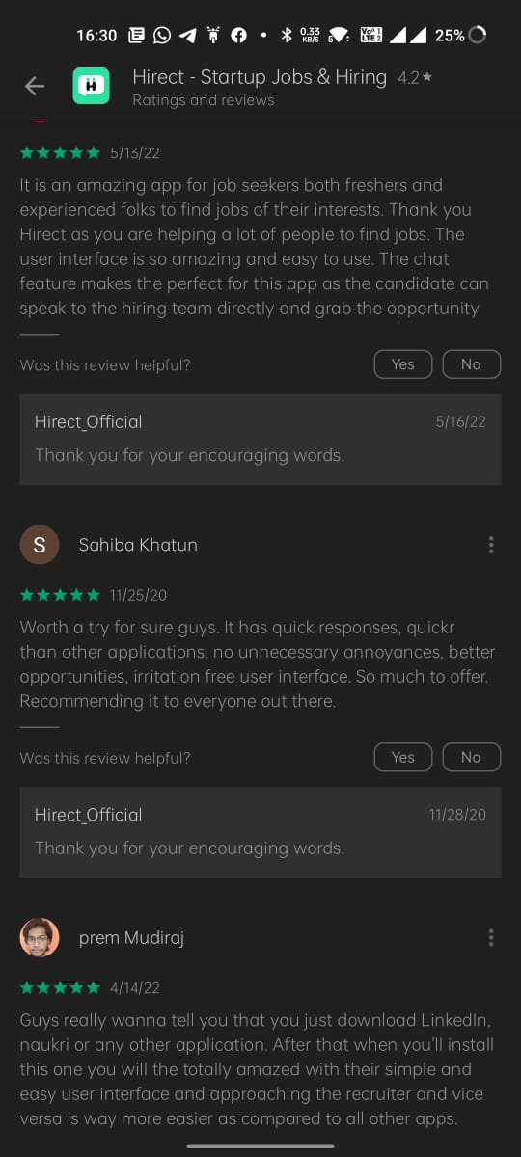
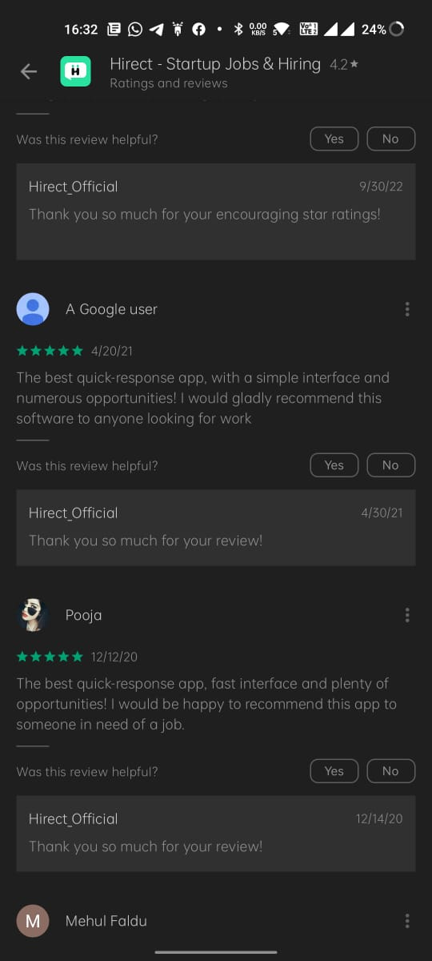
Review Tracking

Slide 16
Thank You

